Slide 1
typography and color theory in web-design
By: Rashni Thapa Magar
Babita Khatri

Slide 2
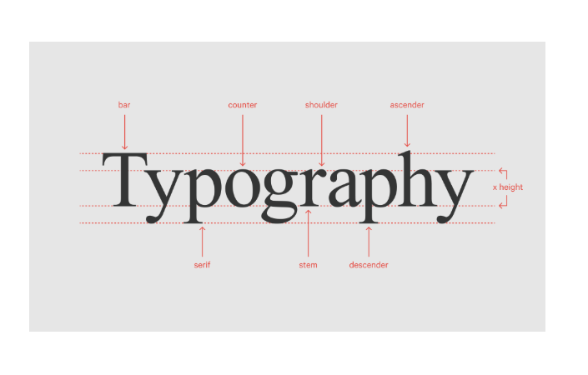

Slide 3
What is Typography in Web-Design?
Typography in web-design refers to the art and technique of arranging text.
It includes font choice, size, spacing and alignment.
It plays a crucial role in user experience and branding.
Good typography enhances readability and creates a pleasant user experience.

Slide 4
Why Typography matters?
Typography affects readability. Usability and the mood of a website.
Good typography ensures that content is clear, legible, and accessible to all users.
Font choice impacts brand identity and can influence user trust.

Slide 5
Key Elements of Typography :
Font Selection
Font Size
Letter Spacing
Font weight and Style
Text-Alignment
Text Contrast and Color
Text Decoration

Slide 6
What is Color Theory in Web-Design?
Color theory is the use of color to create visual harmony.
It includes understanding how colors work together to evoke emotions and guide users.

Slide 7
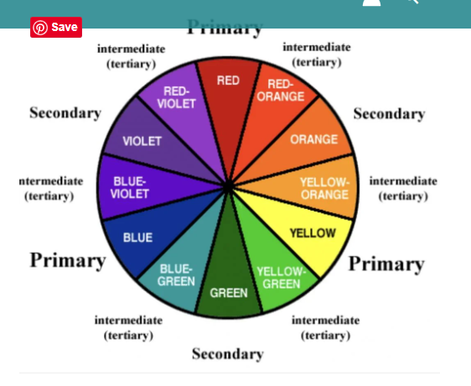
Color Wheel
Primary Colors: Red, Blue, Yellow
Secondary Colors: Green, Orange, Purple
Tertiary Colors: Mix of primary and secondary (e.g. Red-Orange)

Slide 8
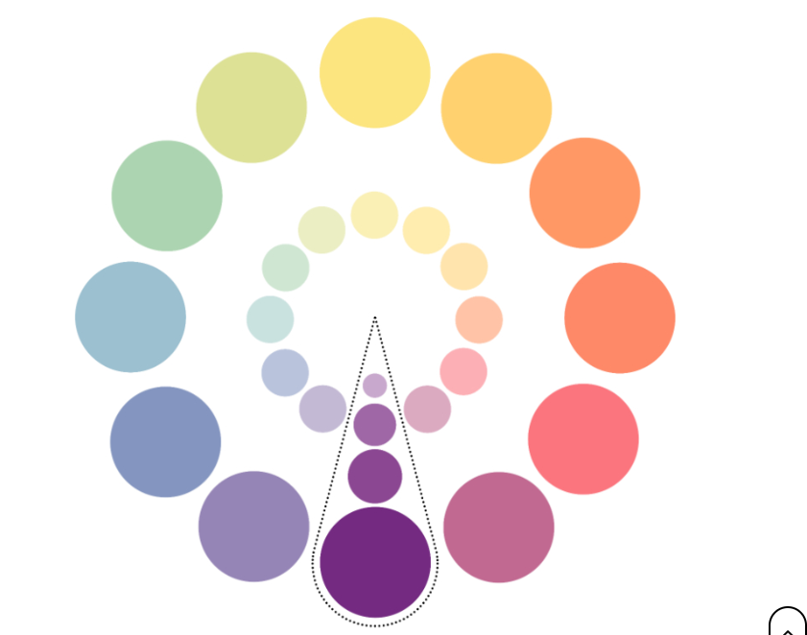
Color Schemes
Monochromatic: Uses variations of one color
Analogous: Colors next to each other on the color wheel
Complementary: Colors opposite each other on the wheel(e.g. blue and orange)
Triadic: Three equally spaced colors (e.g. red, blue, yellow)

Slide 9
Color Psychology in Web-Design
Colors can evoke emotions and influence behavior.
Red: Excitement, urgency
Blue: Trust, professionalism
Green: Calm, growth
Yellow: Optimism, happiness
Purple: Creativity, luxury

Slide 10
Combination of Typography and Color in harmony:
Use complementary or analogous colors to enhance typography.
Maintain contrast for readability, especially for text on colored backgrounds.
Consistent use of color and typography reinforces our design message.

Slide 11
Best practices for Typography and Color:
Keep typography legible and simple.
Choose colors that align with the brand’s message and tone.
Text design on various devices to ensure readability and accessibility.

Slide 12
Conclusion :
Good typography and color choices can make our website more user-friendly and appealing.
Always test for legibility, accessibility and consistency.
Combining both elements well can greatly enhance the user expeirence.

Slide 13
Thank you for your attention! Any questions………….

